Slide 1
So glad you are here for our virtual Open House!
Mrs. Darden

Slide 2
The School Improvement Plan will be available for viewing on the Buck Lake website in the near future. I will let you know when it is available. Thanks!

Slide 3
Classroom Tour

Slide 4
Mrs. Sonja Darden
This is my 28th year of teaching Kindergarten! I taught at Perry Primary for 5 years and Fort Braden for 6 years. This is my 17th year at BLE.
I have been married to Kevin for 18 years and have 2 sons (Jacob at Lincoln and Owen at Leon) and a kitty named Livy.

Slide 5
I sent home our Daily Schedule in your child’s folder and it can be found by clicking here . Please let me know if you have questions.
Click here to view our Special Area Schedule. I will send home a monthly special area calendar at the beginning of each month.

Slide 6
    Grading Policy
    Please click here to view my grading policy. I included kid-friendly symbols that will be marked on papers. For the first nine weeks K students will only have behavior and work study grades.
2021-2022
Interim Progress Report Dates: Report Card Dates:
September 6th (none for K) October 27th
November 17th January 12th
February 9th March 30th
April 20th May 25th

Slide 7
Homework
The Monthly Homework Calendar and Reading Log are due the last school day of the month.
The Wonders Unit Reading packet is due the date of the Unit Test.
The Math Packet should be completed by the date of the Chapter Test. I do not need it returned to school.
Note: I will send out test dates in my weekly newsletters. I also usually write the test date on the homework packet.

Slide 8
Student Assessments
I assessed every student on the kindergarten basic skills . I am sending home a parent report in folders on Friday, 9/3. This is just a baseline for you to see how your child scored. I did assess them on all 40 K sight words. No worries…they have until the end of the year to master these skills!

Slide 9
Parent Conferences
I will send a Sign-up Genius link in mid September to schedule our virtual parent-teacher conference. If you have questions or concerns prior to our meeting just send me an e-mail or call me. I am available to help if needed!

Slide 10
Buck Lake Spirit Store
Click here to buy your Bobcat Spirit Gear now! There’s also a donation option. We won’t be doing heavy fundraising this year, so if you’re interested in supporting our school, this is a great way to do it. The store is live until tomorrow, September 3rd!

Slide 11
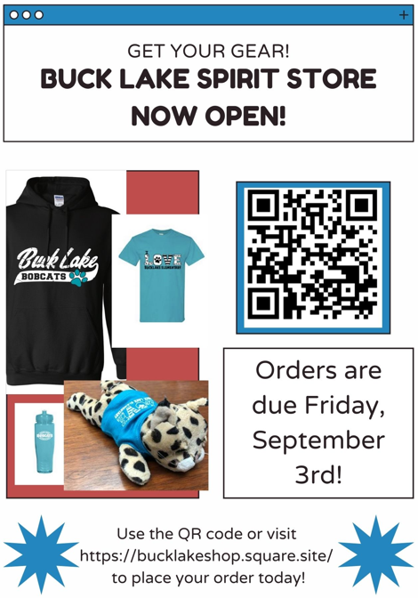
Buck Lake Spirit Store

